Slide 1


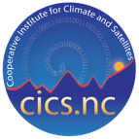

R2O in satellite observations
S. A. Ackerman¹, E. H. Berbery², O. Brown³, C. Kummerow⁴, and F. Miralles-Wilhelm⁵
CIMSS¹, CIC-MD²,CICS-NC³, CIRA⁴, CICS⁵

Slide 2

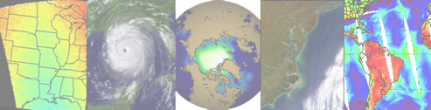
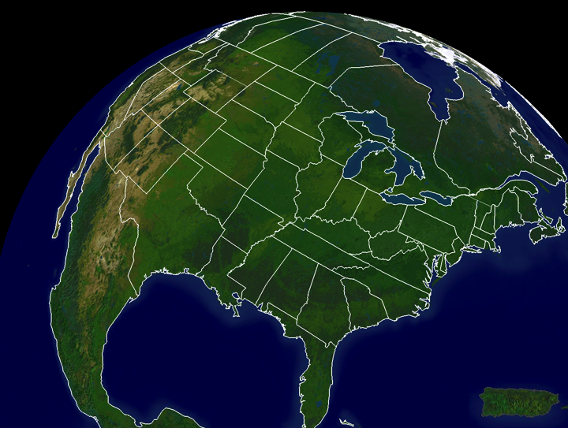

NESDIS Cooperative Institutes
CIOSS
CIRA-RAMMB
CIMSS-ASPB
CICS- SCSB
Hampton Univ
Bowie State
CREST
City College of NY
City Univ NY
Columbia Univ
Lehman College
Univ. Puerto Rico

Slide 3
NESDIS Cooperative Institutes
Collocation of NOAA and University scientists forms a community that is immersed in a collaborative environment, a framework between the research sector and operations realizes the benefits of tight linkages that drive it forward.

Slide 4
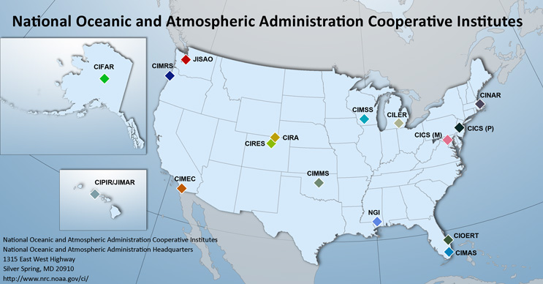
NOAA Cooperative Institutes
NOAA supports 16 Cooperative Institutes consisting of 42 universities and research institutions across 23 states and the District of Columbia.

Slide 5
Outline
Thoughts on R2O
Example successes of CI activities (NESDIS)
Summary: Why CIs work in R2O

Slide 6
The Board on Atmospheric Sciences and Climate of the National Research Council
..mutually beneficial R2O practices:
A research program that understands operational requirements;
Adequate resources, including continuous development of new observing, technological, and modeling capabilities, and sufficient plans;
A sustained interface with users, promoting two-way feedback;
Notes:
Their 2000 report

Slide 7
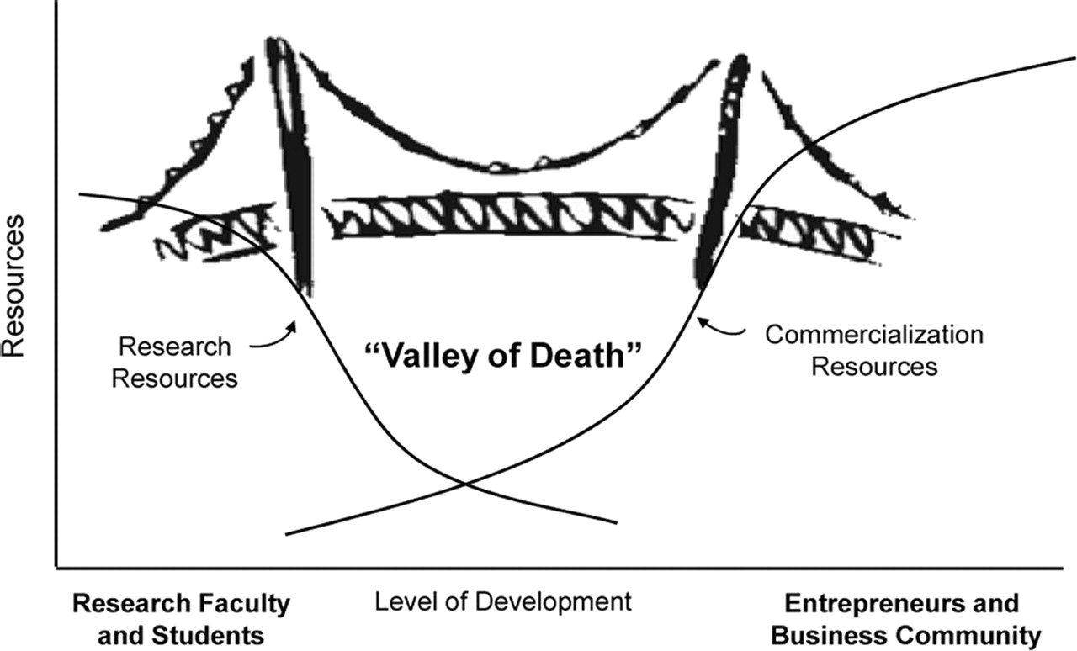
R2O
Bridging the Valley of Death: Lessons Learned From 14 Years of Commercialization of Technology Education
Notes:
To simple a model as now one bridge will work in a particular crossing.

Slide 8




R2O
Bridging the Valley of Death: Lessons Learned From 14 Years of Commercialization of Technology Education
Notes:
To simple a model as now one bridge will work in a particular crossing.

Slide 9
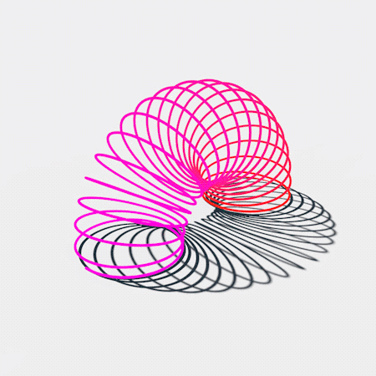
R2O
R2O should be more dynamic than a bridge. Not an isolated process for a single deliverable; a holistic process as R2O cycle delivers research results that fit into operations.
Involves a community that is adequately immersed in a collaborative framework between the research sector and operations; there are tight linkages that drive it forward.

Slide 10

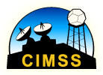
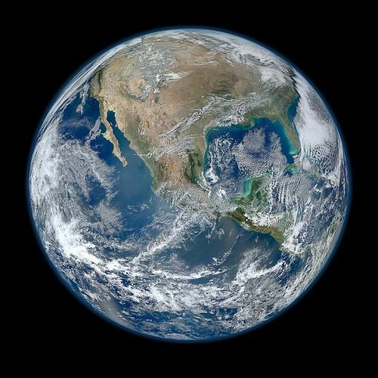
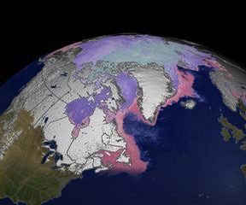
NOAA at CIMSS:
The Advanced Satellite Products Branch
NOAA/NESDIS Center for Satellite Applications and Research (STAR)
ASPB develops products from environmental satellites for short-term weather forecasting and monitoring of the earth-atmosphere system.

Slide 11
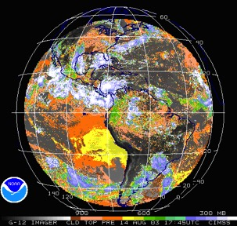
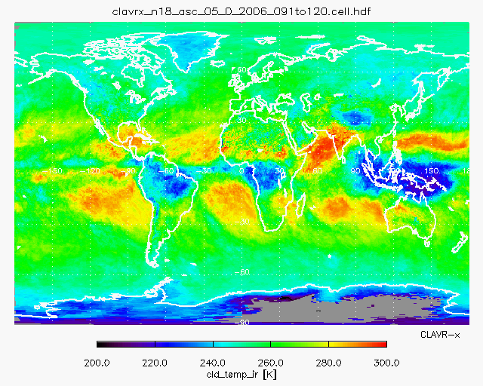

ASPB - CIMSS Synergy
The cooperative institute arrangement provides NOAA with a rich, stable, and flexible research environment to help fulfill the NOAA mission...
NOAA scientists collaborate extensively with CIMSS scientists on basic research, experimental product development, and the transition of research products to operations.
The university environment is conducive to outreach activities. Graduate and undergraduate students are involved in NOAA-funded research.

Slide 12
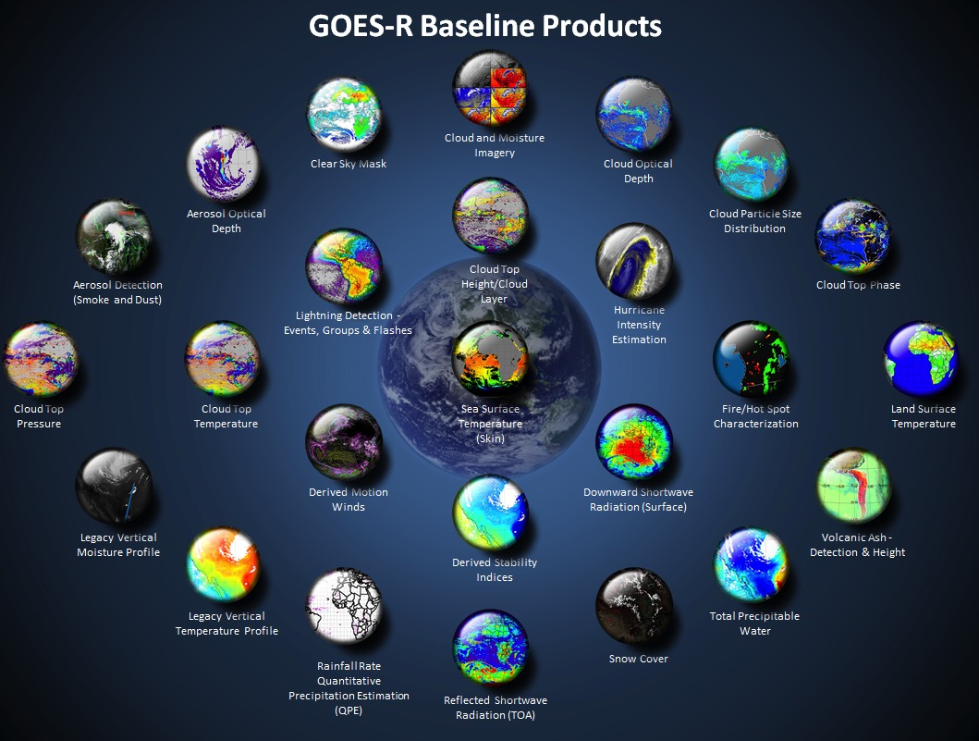
http://www.goes-r.gov

Slide 13
ABI L1b Product
Radiances
ABI L2+ Products (con’t)
Downward S/W Radiation: Surface
Fire/Hot Spot Characterization
Hurricane Intensity Estimation
Land Surface Temperature
Legacy Vertical Moisture Profile
Legacy Vertical Temperature Profile
Rainfall Rate/QPE
Reflected S/W Radiation: TOA
Sea Surface Temperature
Snow Cover
Total Precipitable Water
Volcanic Ash: Detection and Height
ABI (Pathfinders) Products
Aerosol Particle Size
Cloud Layers/Heights
Ice Thickness
Land Surface Temperature
Low Cloud and Fog
Ice: Concentration
Ice: Motion
ABI L2+ Products
Cloud and Moisture Imagery (KPP)
Aerosol Detection (Smoke & Dust)
Aerosol Optical Depth (AOD)
Clear Sky Mask
Cloud Particle Size Distribution
Cloud Top Height
Cloud Top Phase
Cloud Top Pressure
Cloud Top Temperature
Derived Motion Winds
Derived Stability Indices
GOES-R/16 ABI Level 2 (derived products)
Team Leads or key group members located in Madison, WI
24 out of 31

Slide 14
GOES-R ABI Products
Baseline Products
Future Capabilities
Advanced Baseline Imager (ABI)
Aerosol Detection (Including Smoke and Dust) Aerosol Optical Depth (AOD) Clear Sky Masks Cloud and Moisture Imagery Cloud Optical Depth Cloud Particle Size Distribution Cloud Top Height Cloud Top Phase Cloud Top Pressure Cloud Top Temperature Derived Motion Winds Derived Stability Indices Downward Shortwave Radiation: Surface Fire/Hot Spot Characterization Hurricane Intensity Estimation Land Surface Temperature (Skin) Legacy Vertical Moisture Profile Legacy Vertical Temperature Profile Radiances Rainfall Rate/QPE Reflected Shortwave Radiation: TOA Sea Surface Temperature (Skin) Snow Cover Total Precipitable Water Volcanic Ash: Detection and Height
Advanced Baseline Imager (ABI)
Absorbed Shortwave Radiation: Surface Aerosol Particle Size Aircraft Icing Threat Cloud Ice Water Path Cloud Layers/Heights Cloud Liquid Water Cloud Type Convective Initiation Currents Currents: Offshore Downward Longwave Radiation: Surface Enhanced “V”/Overshooting Top Detection Flood/Standing Water Ice Cover Low Cloud and Fog Ozone Total Probability of Rainfall Rainfall Potential Sea and Lake Ice: Age Sea and Lake Ice: Concentration Sea and Lake Ice: Motion Snow Depth (Over Plains) SO₂ Detection Surface Albedo Surface Emissivity Tropopause Folding Turbulence Prediction Upward Longwave Radiation: Surface Upward Longwave Radiation: TOA Vegetation Fraction: Green Vegetation Index Visibility
CI involved with over 56% of earth-facing GOES-R algs.
+ others

Slide 15
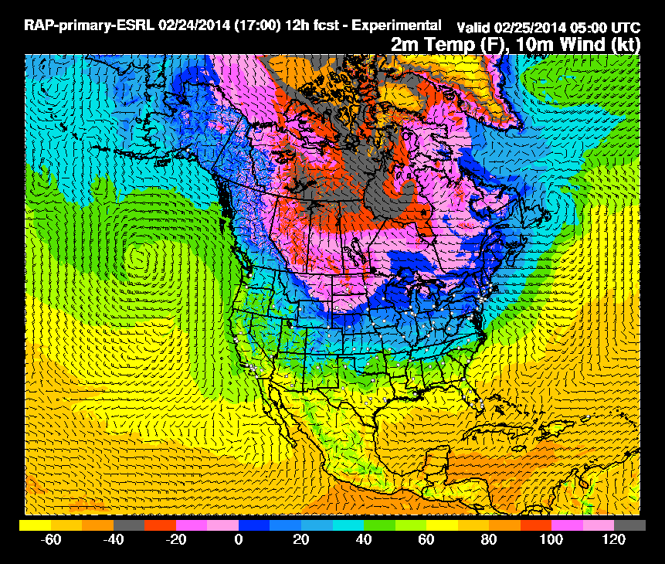
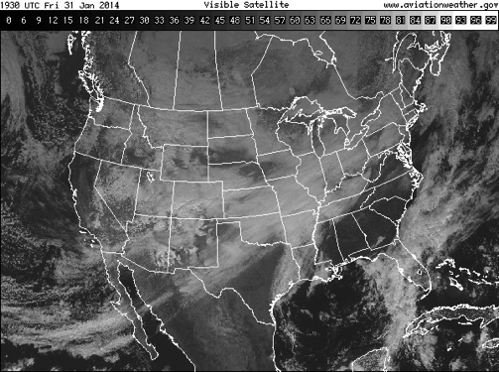
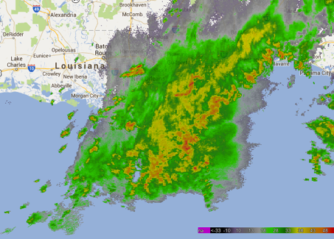
Problem: Converting “Big Data” to Information
High-res Numerical Models
Satellite
Radar
1). Storm Environment
(Energetics of atmosphere)
3). Radar Intensity
2). Development of clouds in time captured by GOES
Probability a developing thunderstorm will produce severe weather in the future (up to 60 minutes)
Some examples of success provided at end….
Notes:
-Forecasters are confronted with large volumes of data relevant to severe weather
-Pre-storm environment: NWP and analyses
-In the relatively short time between the end of the pre-cumulus environment and convective initiation satellite data are often used in a qualitative manner
-After convective initiation, radar is easily the primary tool
-Satellite movies are used to qualitatively observe the evolution of cloud fields
-While satellite data alone is not a sufficient tool for warning operations, it has been significantly underutilized in the severe weather forecasting process.
-Prior to storm development high resolution models and analyses are used to extensively. Once storms form radar becomes the primary forecasting tool. Satellite imagery is most often used in a qualitative manner and is generally used very little once a radar signature develops.
-We have developed methods to utilize NWP, satellite, and radar data in a quantitative manner to improve short-term severe weather prediction using a simple statistical framework.
-The tool is called ProbSevere

Slide 16
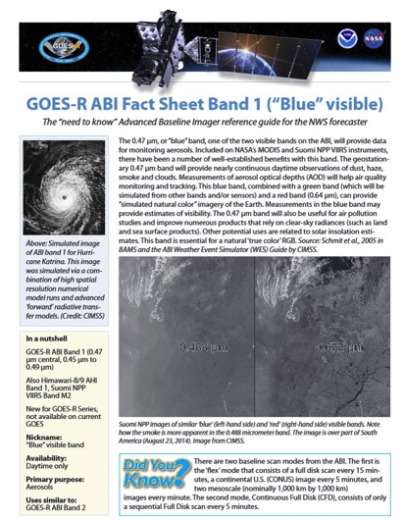
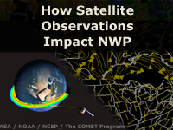
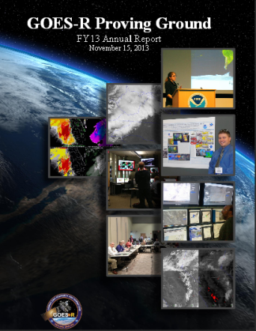
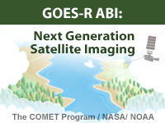
Training and User Education Materials
New!
Online Training Modules
How Satellite Observations Impact NWP
GOES-R ABI: Next Generation Satellite Imaging (COMET)
GOES-R: Benefits of Next-Generation Environmental Monitoring (COMET)
Satellite Hydrology and Meteorology for Forecasters (SHyMet)
SPoRT product training modules
VISIT Training Resources
Commerce Learning Center
ABI Band Fact Sheets
New!
Printed Materials
GOES-R Fact Sheets (18)
User Readiness Plan
GRB Downlink Specifications and Product Users Guide
Proving Ground Demonstration Final Reports and Annual Reports
16
Notes:
GOES-R: Benefits of Next Generation Environmental Monitoring - Includes an overview of the mission, instruments, system and services, satellite synergy, the role of GOES-R in the Global Observing System as well an environmental monitoring section that addresses the benefits of GOES-R and the ability to monitor 13 unique hazards and phenomena.
GOES-R 101 - Targeted for Forecasters and anyone else interested in basic aspects of GOES-R
Satellite Hydrology and Meteorology (SHyMeT) - Dedicated to operational satellite meteorology. The Forecaster track of the SHyMet course covers satellite imagery interpretation, including feature identification, water vapor channels, and what to expect on GOES-R. There is a session on remote sensing data for operational hydrology as well as one relating to aviation hazards. Other topics include an understanding of the Dvorak method in tropical cyclone analysis and the utility of cloud composites in forecasting
CIMSS Satellite Meteorology for Grades 7-12 -Meteorology is an excellent topic to introduce middle and high school students to geoscience, physics, chemistry, and applied mathematics. Satellite Meteorology provides scientists and educators with exciting tools for investigation, inquiry, analysis and stewardship.
Commerce Learning Center: Forecasters can take these training courses and get credit for taking them

Slide 17
Making a better bridge or slinky
NOAA has invested in monolithic ground systems that have taken away all ability for dynamic user-inspired science driven products or processing.
Universities, like UW-Madison, often are the source of the original algorithms that become part of the baseline processing of these large ground systems and have extensive interactions with NOAA's users.
Universities would therefore be ideal places for demonstrating new or evolved products and applications. They could be small "o" operational centers that are not encumbered by the requirements of the big "O" operational centers.
Notes:
NOAA has invested in monolithic ground systems that have taken away all ability for dynamic user-inspired science driven products or processing.
Universities like UWM often are the source of the original algorithms that become part of the baseline processing of these large ground systems and have extensive interactions with NOAA's users.
Universities would therefore be ideal places for demonstrating new or evolved products and applications. They could be small "o" operational centers that are not encumbered by the requirements of the big "O" operational centers.
For this to work, both "O"s need to communicate and see mutual benefit. The small "o" centers need to be funded directly inline with the big "O"s and users need funding to ensure their engagement.
The Proving grounds were effective as the little "o" but were not aligned with the big "O" and have limited impact on them.

Slide 18
Summary
The CIs are research communities that include NOAA and University scientists, the core to the successful relationship, and key success in transitioning research to operations is “collaboration”.
The successful R2O culture requires the operations side to invest in new research and development that will ultimately support their mission.
Research side is open to understanding why operations make certain requests, and how operations is leveraging research outputs.
Not just algorithms

Slide 19




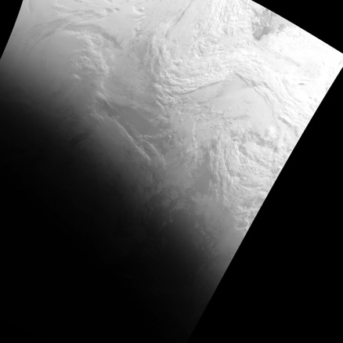
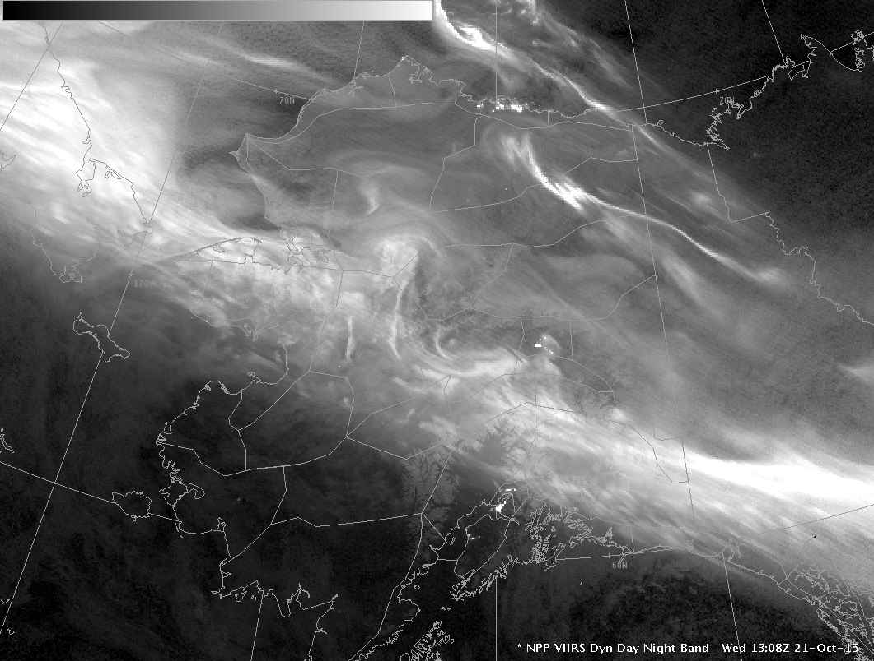
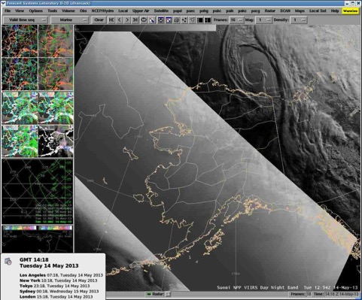
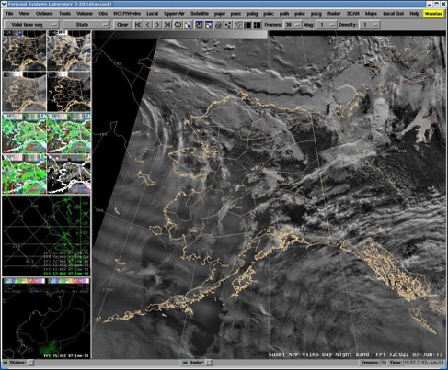
Improving the Display
of DNB Imagery
Logarithmic Scaling
The VIIRS Day/Night Band (DNB) is a revolution for forecasters, offering visible imagery at night.
The DNB is sensitive to light 8 orders-of-magnitude dimmer than full sunlight.
This large dynamic range is difficult to display in 256 colors.
CIRA developed the “ERF-Dynamic Scaling” algorithm to improve the display of DNB imagery.
With the support of CIMSS and GINA, this imagery is now available to forecasters through CSPP and AWIPS.
ERF-Dynamic Scaling
CSPP Histogram
CSPP Adaptive
Eric Stevens, Alaska Region Satellite Liaison: “Screen caps from the AWIPS at WFO Fairbanks show the ‘dynamic’ DNB performs pretty well with the aurora. Just talking informally with a couple of the forecasters there earlier this week, I get the impression they are very happy with this scaling approach.”

Slide 20


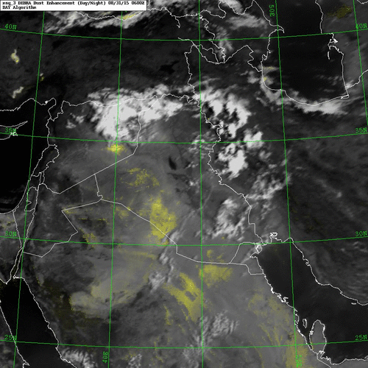
Satellite-Based Dust Storm Enhancements
Cooperative Institutes Facilitate Multi-Agency Partnerships to Achieve Common Goals
NOAA and the DoD share interest in monitoring lofted dust, which poses a serious meteorological hazard.
CIRA has teamed with NRL Monterey to develop a dust enhancement algorithm applicable to next-generation geostationary satellites.
The ‘DEBRA’ technique is being produced operationally by the Navy.
NOAA is now supporting CIRA’s extension of DEBRA for application to new and more capable imagers on Himawari-8 and the future GOES-R.
Above: A large dust storm traverses Iraq over 31 Aug – 1 Sep 2015. The Dynamic Enhancement Background Reduction Algorithm (DEBRA) depicts the lofted dust in shades of yellow.

Slide 21
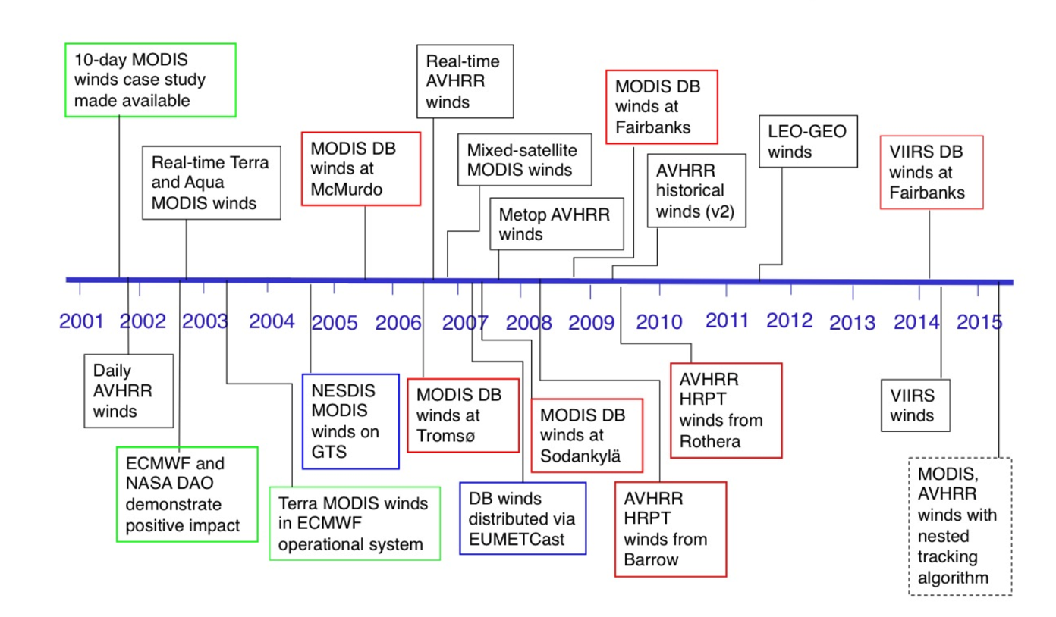
Institutional Memory:
Polar Winds Product History

Slide 22

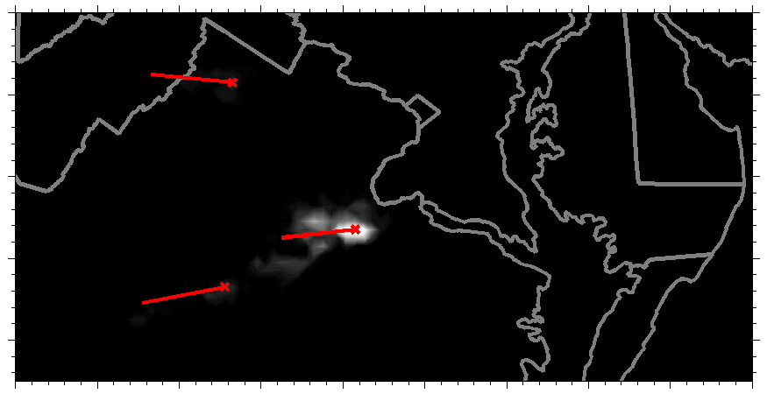
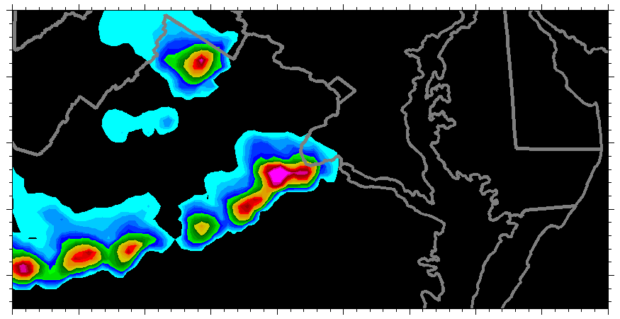
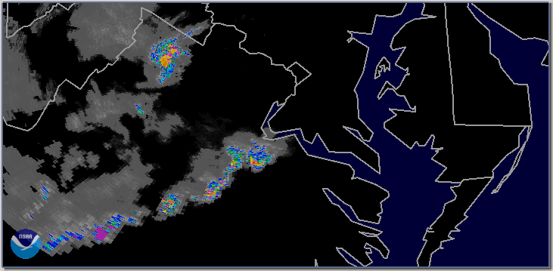
Merging Lightning and LEO
Patrick Meyers (CICS-MD)
Estimated cell direction
1 min intervals
Linearly interpolated in space
Lightning
Motion
Motion using ONLY lightning
New flow field each minute
Original AMSR2 pixels advected and regridded
Rough feature motion
AMSR2 Propagation
NEXRAD
Precipitation
Radar estimate of storm motion
Ground truth

Slide 23
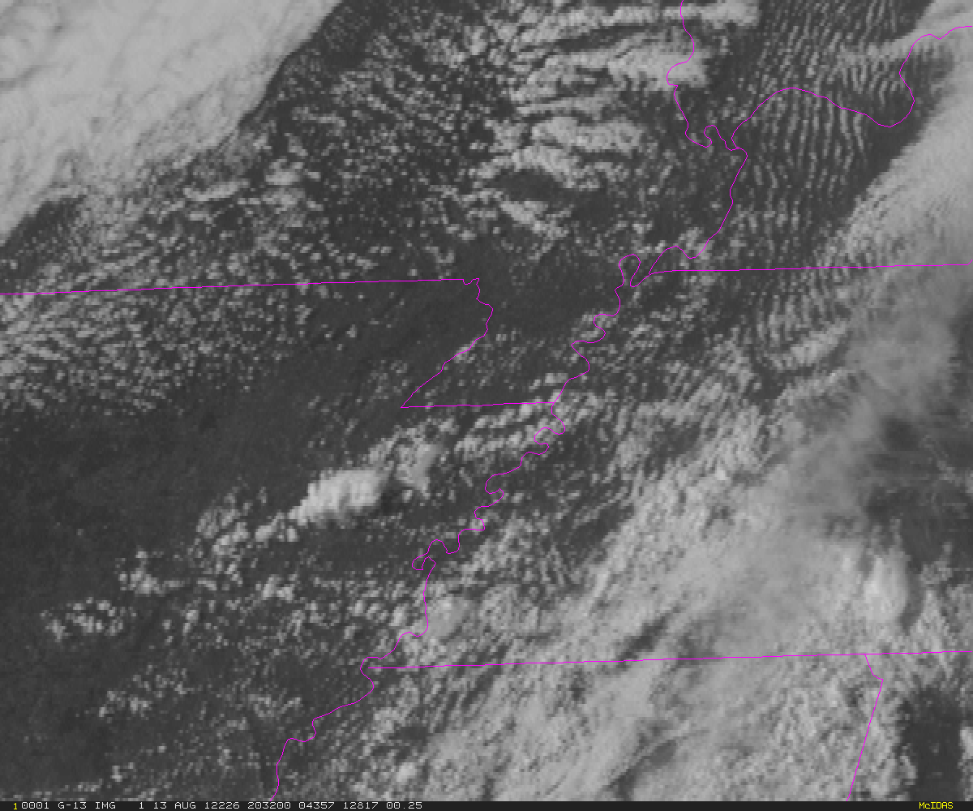
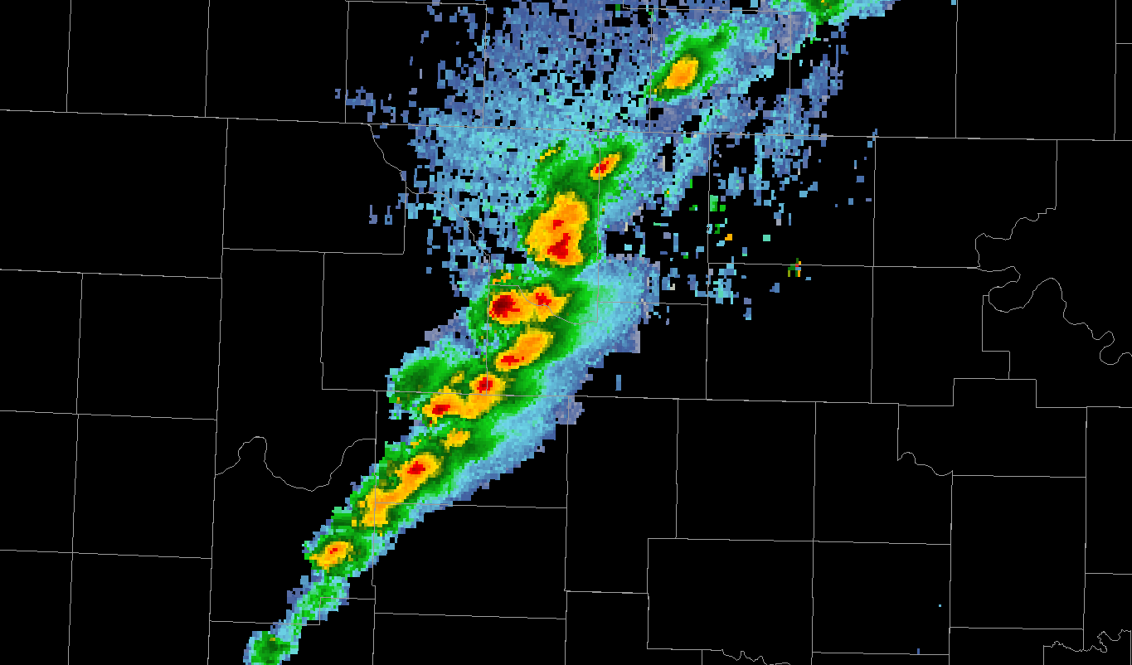
Automated integration of information
A meteorologist sees developing storms and cloud clusters—not satellite pixels or radiances.
The same concepts apply to radar data.
Meteorologists view cells or storms—so the computer needs to identify and track radar cells and their evolution over time.
Notes:
-Extract storm-scale objects and track them in time
-Instantaneous satellite-derived cloud fields are not well-suited to the short-term severe weather forecasting, but temporal trends in those cloud properties are.
-Calculating temporal trends in satellite-derived cloud properties is not a trivial task.
-In order to capture temporal trends in cloud properties, object tracking is needed
-Collaboration with OU-CIMMS and NSSL was essential

Slide 24
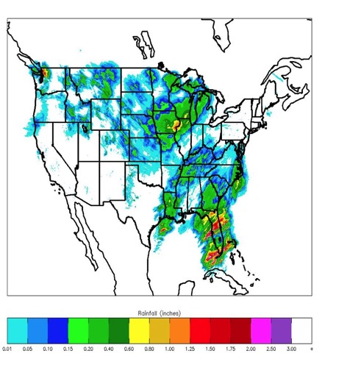


NEXRAD Reanalysis
Provide quality satellite and in situ climate observing datasets to document the Earth’s climate
NEXRAD NMQ/Q2 Reanalysis – NCEI / NSSL / CIMMS / CICS-NC
Joint project with NOAA’s National Centers for Environmental Information, NOAA’s National Severe Storms Laboratory, the Cooperative Institute for Mesoscale Meteorological Studies (Norman, OK), and the Cooperative Institute for Climate and Satellites-North Carolina (Asheville, NC)
Applies National Mosaic and Multisensor Quantitative
Precipitation Estimate (NMQ/Q2) algorithms to the
NEXRAD archive (1997–2011)
Data from NCEI and NSSL, processed on CICS-NC
high-performance computing cluster
Gridded precipitation products at high temporal
(five-minute) and spatial (0.01°/1 km) resolutions
Variety of severe weather products, three-dimensional
radar reflectivity, and quantitative precipitation
estimates at high-resolution
National Oceanic & Atmospheric
Administration
Cooperative Institute for Climate and
Satellites–North Carolina
North Carolina State University
Cooperative Institute for Mesoscale
Meteorological Studies
University of Oklahoma

Slide 25
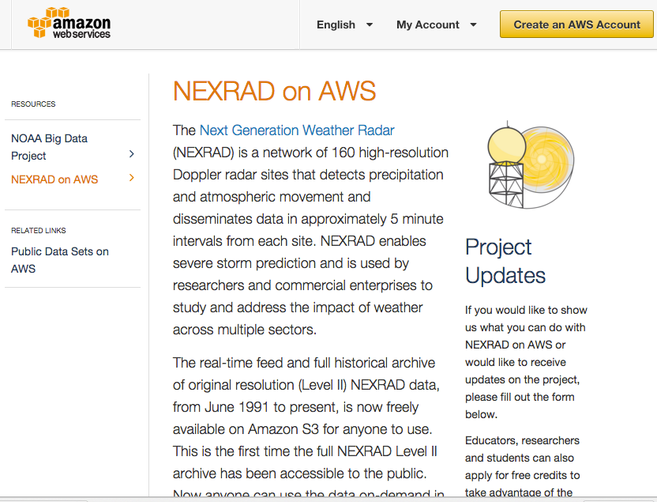

Information Access Models
Support improvements to access mechanisms for NOAA’s data and product holdings at NCEI
NOAA Big Data Project (BDP) – NCEI / CICS-NC
Delivering environmental information via cloud providers (Amazon, Microsoft, Google, IBM, and Open Commons Consortium)
Moved ~ 1PB of data to multiple cloud providers in late 2015
NEXRAD Level 2 live on AWS on
October 27th, 2015
More datasets in the pipeline
https://aws.amazon.com/noaa-big-data/nexrad/
National Oceanic & Atmospheric
Administration
Cooperative Institute for Climate and
Satellites–North Carolina
North Carolina State University

