Slide 1
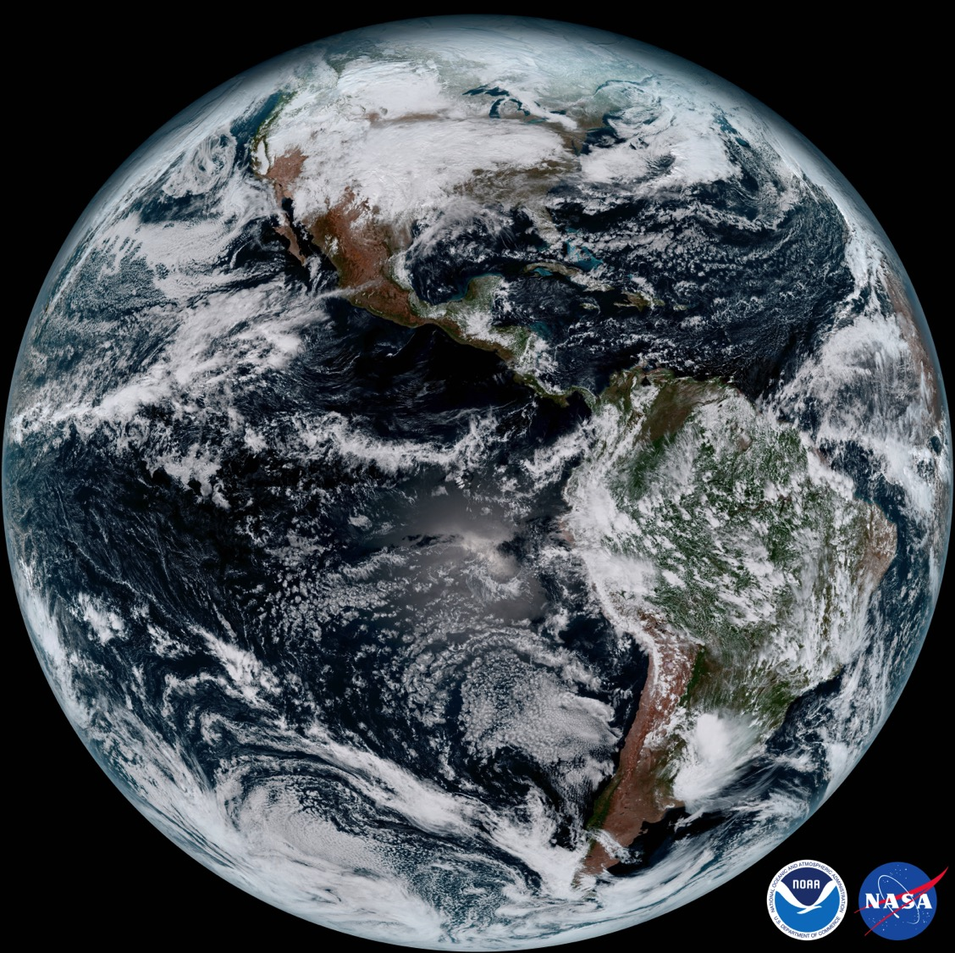
Joint Center for Satellite Data Assimilation
Activities in Support of O2R2O
Thomas Auligné. Director, Joint Center for Satellite Data Assimilation (JCSDA)

Slide 2
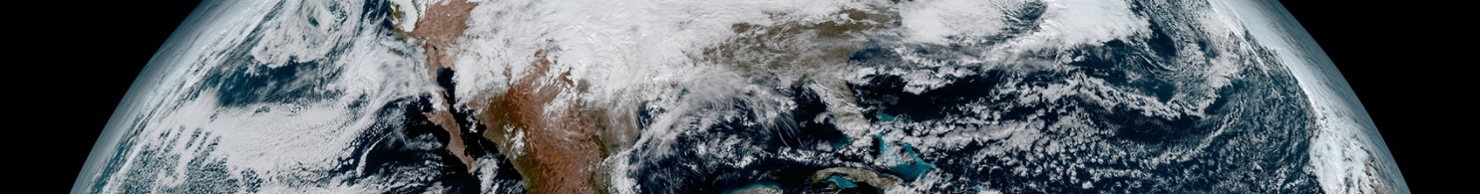

Joint Center for Satellite Data Assimilation
Vision: An interagency partnership working to become a world leader in applying satellite data and research to operational goals in environmental analysis and prediction
NASA
GSFC
U.S. Air
Force
JCSDA
NOAA
NWS
U.S.
Navy
NOAA
NESDIS
NOAA
OAR
Mission: to accelerate and improve the quantitative use of research and operational satellite data in weather, ocean, climate and environmental analysis and prediction models.
Science priorities: Radiative Transfer Modeling (CRTM), new instruments, clouds and precipitation, land surface, ocean, atmospheric composition.

Slide 3
Component of O2R2O Infrastructure
What Money can Buy….
  Proposals (JCSDA external research)
  Supercomputer (Hardware, basic software, and IT) (almost the easiest part!)
  Scientific Software Integration (hardest part: keep in sync with oper models)
  Resources to sustain portability, documentation and user support
  Utilities to help scientists (CRTM, assessment, formatting tools)
  Rigorous software configuration system and testing mechanism
What Money can NOT Buy…. the right culture
  Transparency of R2O protocols and willingness to accept research performed by researchers & work collaboratively (on the operational partner)
  Willingness to work/start with operational system and follow protocols and accept constructive feedback (on the research partner)
Accept that R2O is not for everyone: careful choice of research and operations partners is important

Slide 4
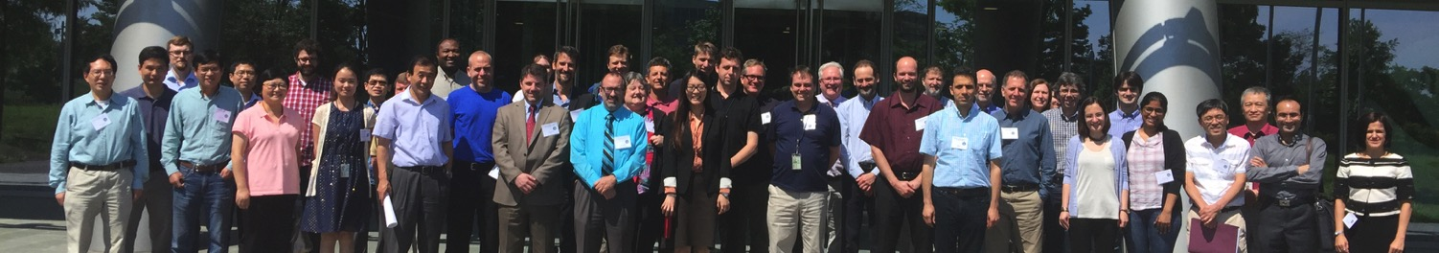
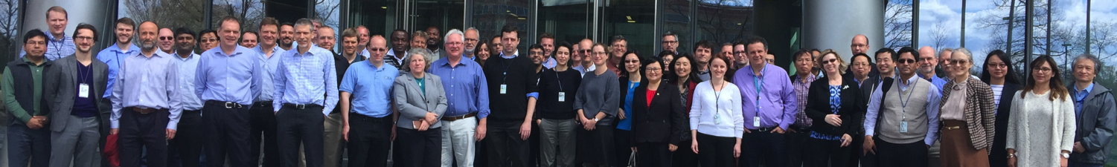
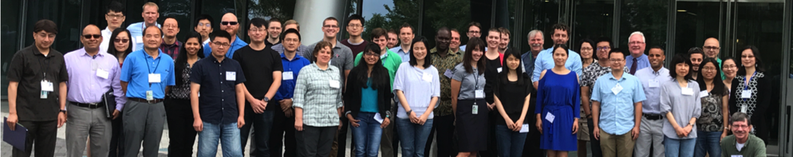
Education and Outreach
  Joint DTC-EMC-JCSDA GSI/EnKF Tutorial
15th JCSDA Tech Review and Science Workshop + 1st CRTM Users and Developers Workshop
Unified DA Planning Meeting
  Joint DTC-EMC-JCSDA GSI/EnKF Tutorial
Joint Workshops with Partners
  JCSDA Symposium @AMS: Austin, TX
Summer Colloquium on Satellite DA
  Summer 2018: Bozeman, MT
JCSDA Newsletter and Web site
  Highlight achievements by scientists
  Promote collaboration

Slide 5
Common Scenarios
Scenario #1: new satellite instrument
Observation processing (forward operator, QC, bias correction, error estimation, etc) will be developed several times for OSSEs, Cal/Val, retrievals, verification, climate studies, post-processing and DA.
Scenario #2: new DA algorithm
Will be tested with a (semi-)toy model, resulting in a publication with ‘encouraging results’. The end…
Few algorithms get evaluated in operational relevant environment.
Scenario #3: technology transfer
Importing science from external collaborators usually means reading their publications and recoding from scratch.

Slide 6


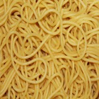
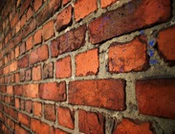
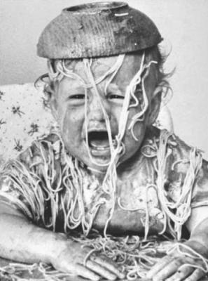

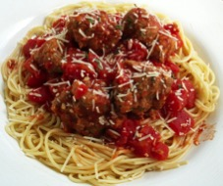
Bad Design is Bad for R2O
Disclaimer: This schematic is over-simplistic.
Operations
Research
Adapted from Chris Harrop

Slide 7
Modern Software Engineering
We want a very flexible, reliable, efficient, generic, readable and modular code.
This is not specific to NWP: the software industry has moved to generic and object-oriented programming 20 years ago.
The key idea is separation of concerns
All aspects exist but scientists focus on one aspect at a time.
Different concepts should be treated in different parts of the code.
Nobody can know it all!
Code efficiency is an important aspect
Experience shows that refactoring generally improves code performance
New structure will make scalability investigations easier

Slide 8
JEDI Vision
The Joint Effort for Data assimilation Integration (JEDI) is a collaborative development spearheaded by JCSDA partners of the next-generation unified data assimilation:
For research and operations (including R2O/O2R)
For various components of the Earth system, including coupled
Mutualize as much as possible without imposing single approach
BENEFITS
Facilitate innovation to address next scientific challenges
  Increase R2O transition rate
Increase science productivity and code performance

Slide 9
Unified Forward Operator (UFO)
Obs. Locations
Variables
State
Obs. Operators
Observations
Interpolated Fields
JEDI Unified Forward Operator (UFO) introduces standard interfaces between the model and observation worlds
Observation operators become model-agnostic and can easily be shared, exchanged, compared
Objective of UFO: build an ‘Op Store’ platform for the community

Slide 10
Ecosystem Bridging R & O
Sandbox
GMAO
NRL
.edu
Exchange
NCAR
Community Repository
Community
Supported
ESRL
Push +Pull request
NCEP
Prod
Fork
…
Oper
Oper
Center
JEDI Ecosystem
Modular, flexible, OO code
Agile collaborative development
Portable environment (containers)
Continuous integration

Slide 11

Computing Strategy for R2O
R2O
Computing Resources
Preparing
for future
NOAA HPC
Parallel
suite
Regression
test
Various machines?
Cloud Computing?
System
test
Function
test
Unit
test
Laptop, Desktop, Server
Testing complexity/resolution
Code portability: we are paying the technical debt, i.e. the trade-off between writing clean code at higher cost and delayed delivery, and writing messy code cheap and fast at the cost of higher maintenance efforts once it's shipped.
Evidence-based decision: large expensive experiments to achieve statistical significance
Issue: JCSDA available platforms (JIBB, S4) are reaching warranty life in 2018

Slide 12
Concluding Remarks
O2R and R2O are two sides of the same coin
Successful R2O requires:
the right $$$
the right people
the right culture
the right software
the right computers
the right development ecosystem

Slide 13
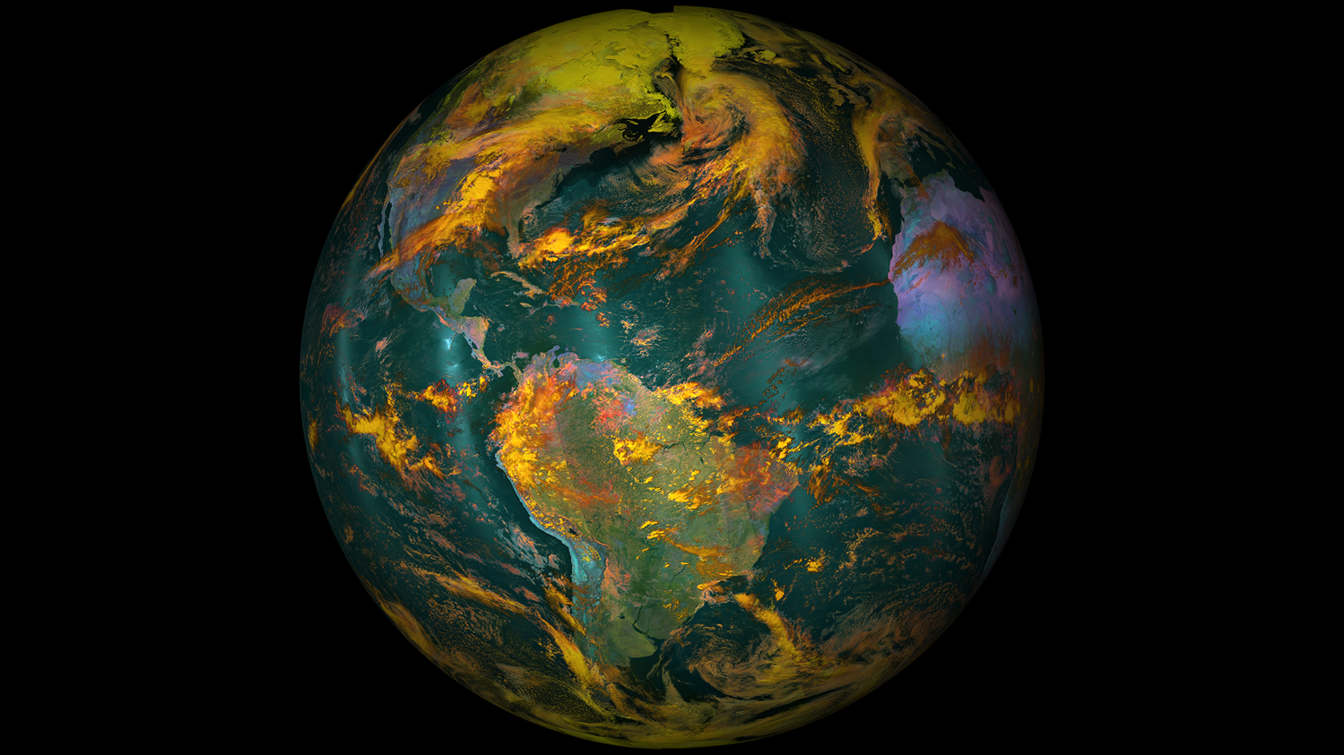

Discussion…

